Slide 1










BSB
Bay Side
BIOREFINERY
Group 1
By : Audrey Ferris, Maria Konstantinovski, Sulagna Nandi, Hana Kim, Claire Chisholm and Luca Madriz-Zikic

Slide 2

BSB
TABLE OF CONTENTS
Cornerbrook NL
01
Biomass Availability
06
The Need for Sustainable Biofuels
02
Energy Supply & Demand
07
Environmental Factors
03
Biomass Availability
08
Impact on Ecology & Society
04
Economic & Logistical Advantages
09
Energy Technology Overview
05
Next Steps
10

Slide 3


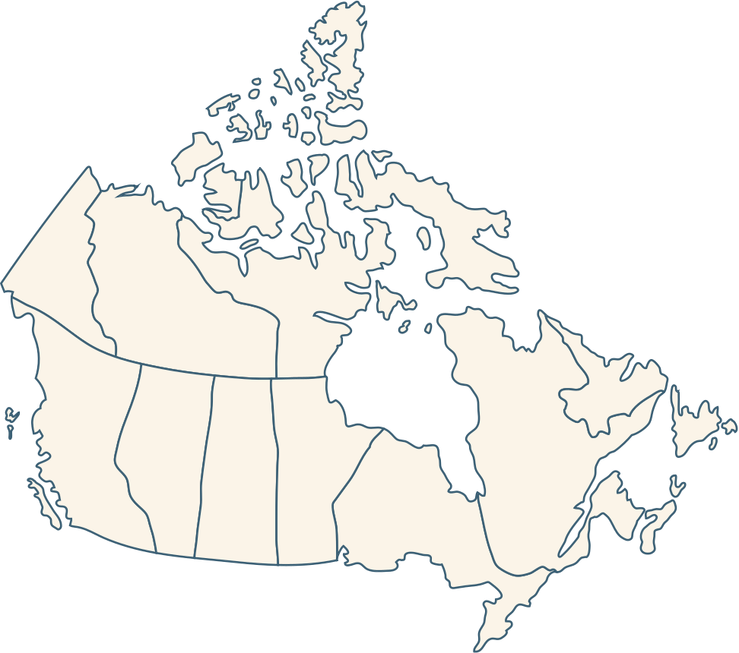

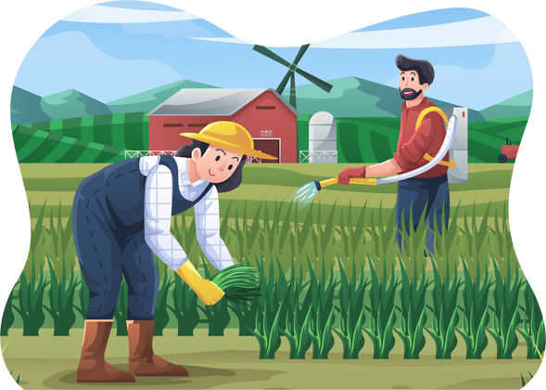
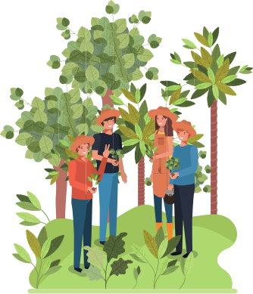

BSB
CORNERBROOK, NL
01
01
Population: 19, 333
Agriculture
Forestry
Fishery

Slide 4
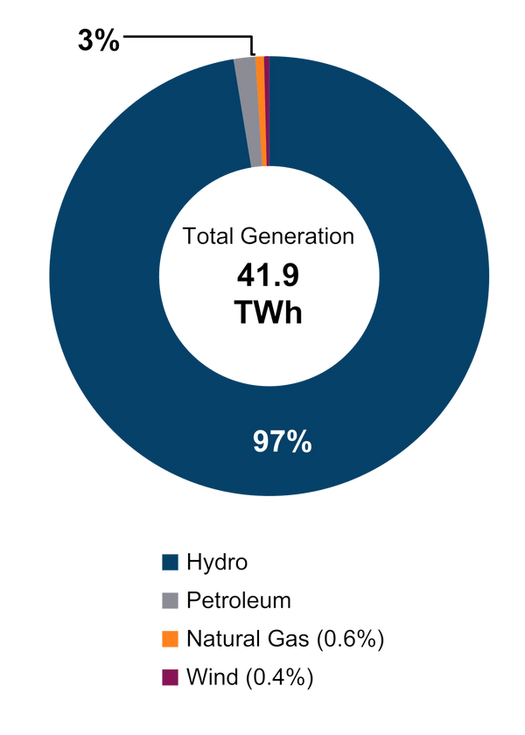


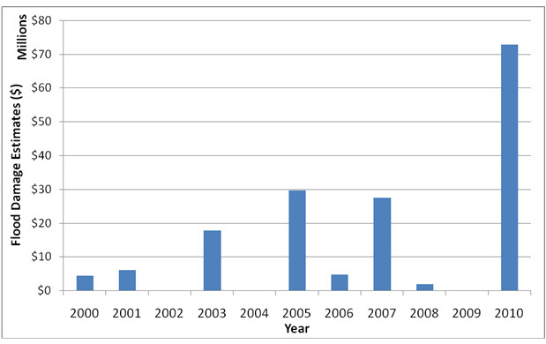
BSB
THE NEED FOR SUSTAINABLE ENERGY
02
Reliance on Hydropower
Current problems
Environmental Disruption
Figure 2: Total DFAA Flood Damage Estimates in Newfoundland (2000–2010)
Government of Newfoundland and Labrador. Flooding in Newfoundland and Labrador.
https://www.gov.nl.ca/ecc/waterres/flooding/flooding/
Climate Change Mitigation
Figure 1: Electricity Generation Mix in NL (2023)
Canada Energy Regulator. Provincial and Territorial Energy Profiles: Newfoundland and Labrador.
https://www.cer-rec.gc.ca/en/data-analysis/energy-markets/provincial-territorial-energy-profiles/provincial-territorial-energy-profiles-newfoundland-labrador.html

Slide 5
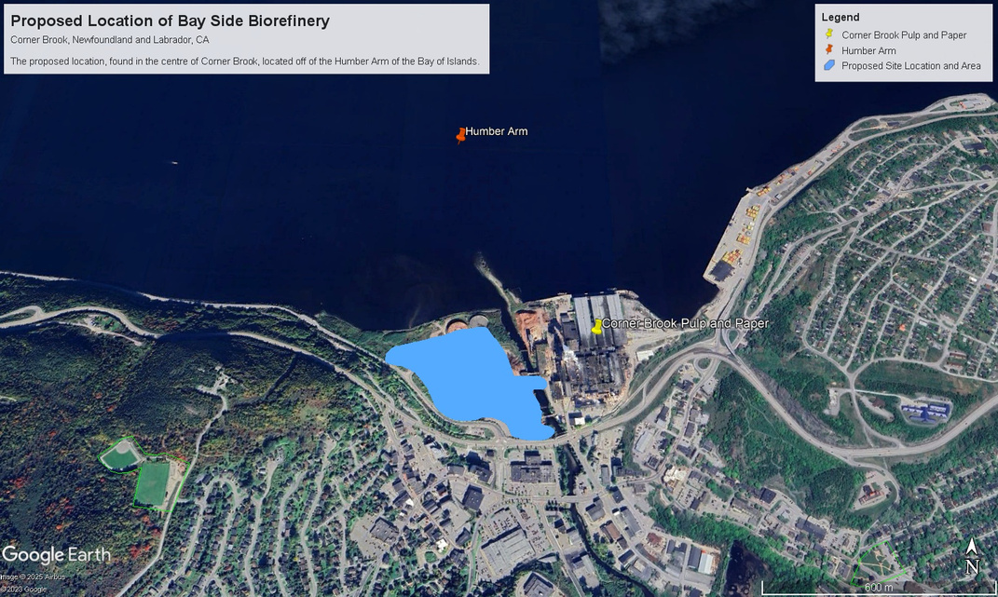
BSB
ENVIRONMENTAL FACTORS
03
Land Factors
Proposed area includes/needs:
Specific Climate Conditions
Geological composition
Elevation and Slope
Emissions and Resources
Considerations:
Carbon dioxide emissions
Water consumption and requirements
Google Earth Pro version 7.3.6 (10/6/2023). Map of Corner Brook, Newfoundland and Labrador. 48°57’18.47”N 57°57’02.31”W, 1.21km. (February 13, 2025)"
Notes:
Geological composition:
- bedrock, permeability,
porosity, etc (mudslides)
- Elevation and slopes
- minimal change in slope,
unlikely landslides
- specific climate conditions
- area has high precipitation (rain and snow) therefore makes mudslides more probable - can be prevented through thorough drainage systems from permeable sedimentary rock layer to coast
Considerations:
- Carbon dioxide emissions are 10x lower in biofuel production than those of fossil fuel production
- will implement carbon capture tech to repurpose captured carbon for industrial applications
- water consumption is cut down significantly compared to traitional fermentation energy since we are focusing on utilizing forestry and organic waste rather than growing crops for the sole purpose of fermentation
- Ties in with required land space - less overall land requirements since we're not growing crops but instead are itlizing waste and biomass!!

Slide 6




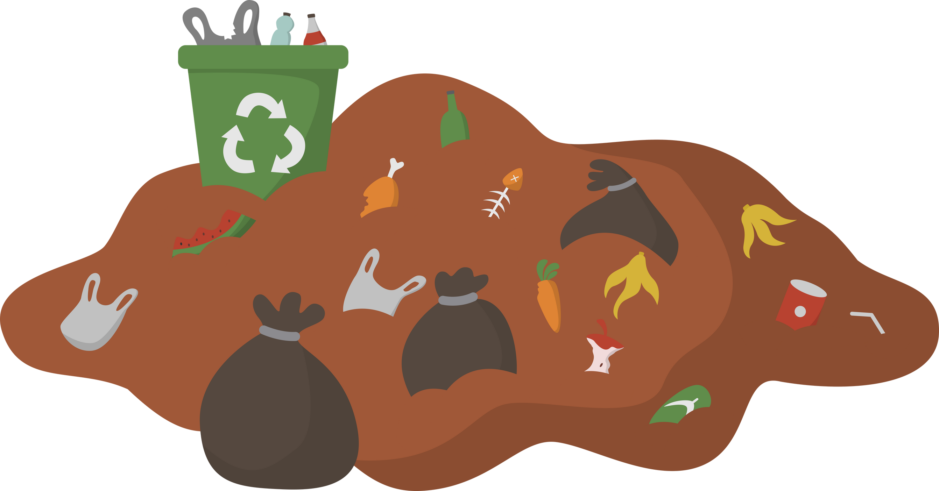
BSB
IMPACT ON ECOLOGY & SOCIETY
04
Use of existing forestry residues and CBPP waste to reduce growing landfills
Reduce CO₂
emissions to expand species’ realized niches and reduce disruption
Job opportunities across multiple sectors

Slide 7
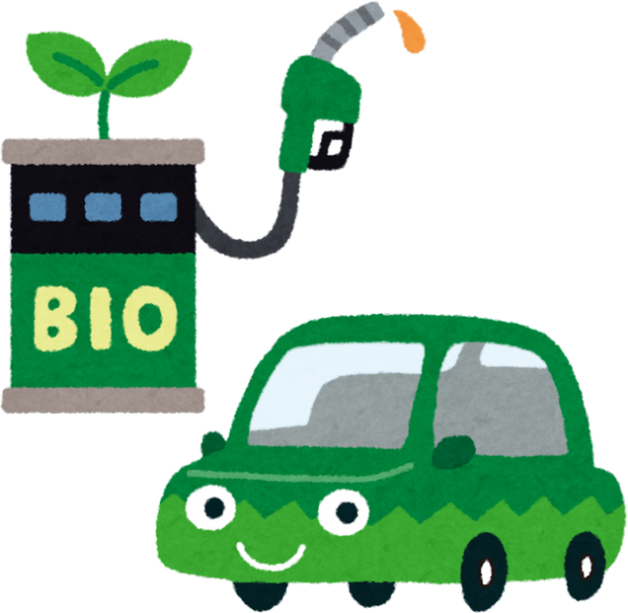
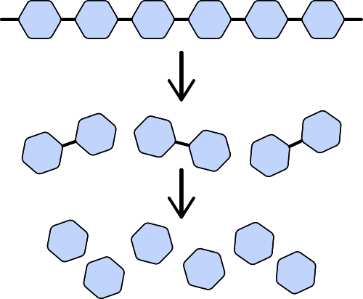


BSB
TECHNOLOGY OVERVIEW
05
Sourcing
Pre-treatment
Detox.
E.H.
Fermentation
CBPP
Sawmills
Agricultural Waste
Steam Explosion
Disrupt Struture
pH Modulation
intermediate step
Breakdown
Sugar Yields
Bacteria + Yeast
Glycolysis
Ethanol production

Slide 8







BSB
BIOMASS AVAILABILITY
06
41, 211 tonnes of forestry waste / year
47 500 tonnes of paper sludge / year
150 000 tonnes of organic waste / year
149 960 tonnes of fishery waste / year

Slide 9
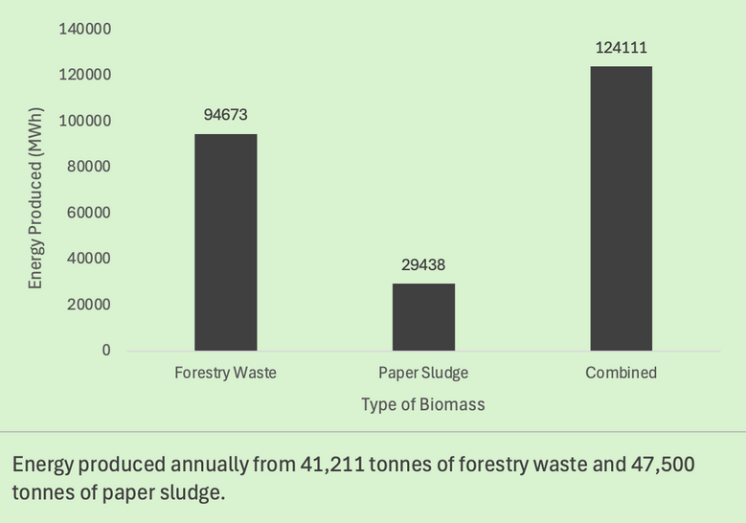

BSB
ENERGY SUPPLY & DEMAND
07
124 GWh energy output, meeting the meetingdemands
Accounts for biomass, sugar yield, fermentation, ethanol content
Enzymes improve sugar conversion, reduce processing time
Gompertz Model for ethanol monitoring and optimization
Expanded feedstock enhances sustainability, energy security

Slide 10
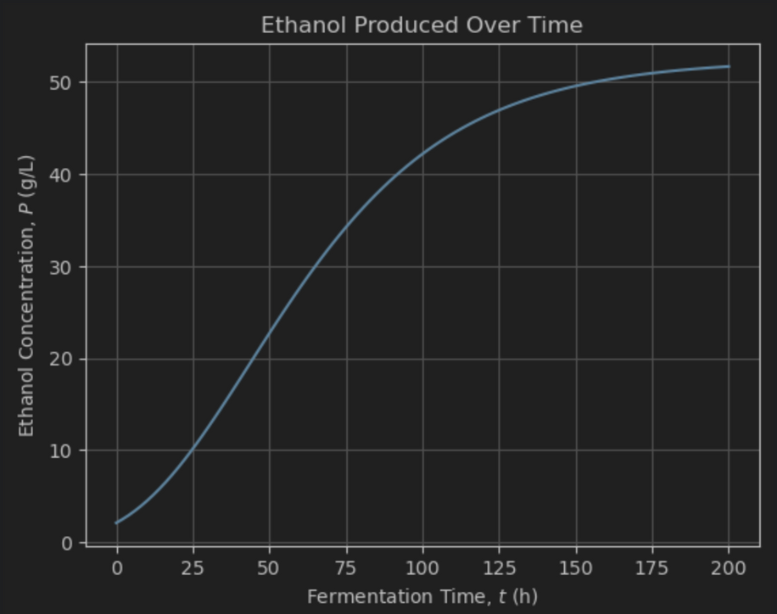
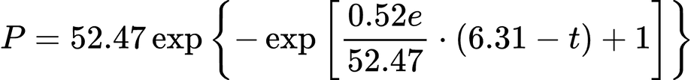
BSB
ENERGY SUPPLY & DEMAND
07
Modified Gompertz Model

Slide 11


BSB
ECONOMIC FEASIBILITY
08
Job Creation
Boosted Local Forestry & Agriculture
Market Demand
Enhanced Export Potential
Centralized Infrastructure

Slide 12




BSB
NEXT STEPS
09
Further research
Chemical Kinetics
Genetically modified enzymes
Public awareness & community involvement
Securing funding & investment opportunities

Slide 13
BSB
10
QUESTION AND ANSWERS
We value your insights and queries. Now, it's time to open the floor for questions and discussions

Slide 14





BSB
THANK YOU I-DRAGONS
For further inquiries or collaborations, feel free to reach out. Your ideas and enthusiasm drive positive change.
123-456-7890
www.bsb.com
hello@bsb.com
McMaster University istudy, Hamilton Ontraio

